Slide 1
Integrating Marketing Channels into
A Value Creating Network
A Presentation for the MKT 5001 – Marketing Management course
Instructor : Prof. Dr. M. Mahbubar Rahman
Part of MBA at the Department of Marketing
The University of Rajshahi
By Tehzeeb Karim
Student ID: 26100353-20

Slide 2
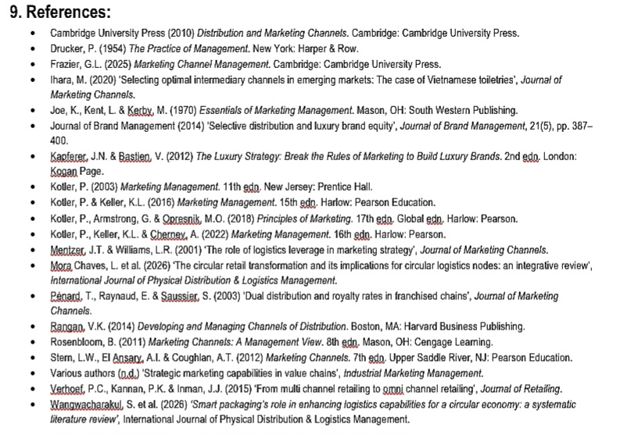
Marketing Channels to Deliver Value
Tehzeeb Karim

Slide 3

Marketing Channels to Deliver Value
Tehzeeb Karim
CONCEPTS AND DEFINITIONS
Definition of marketing channels
Role of intermediaries in bridging producers and consumers
Channel levels (direct, indirect, multichannel)

Slide 4
Marketing Channels to Deliver Value
Tehzeeb Karim
CONCEPTS AND DEFINITIONS
Traditionally, the concept of supply chain takes a linear and limited ‘make and sell’ approach, focusing on factories and raw materials as the starting point for marketing. A more evolved, but also outdated, approach is to manage a demand chain, implying the need to sense the market first and then respond (Kotler, 2003).
Current marketing literature promotes creating a value-creating-network which sees all suppliers, distributors and connected business partners and processes as part of a system to ‘source, augment and deliver’ what the customers value. (Kotler, 2003).

Slide 5
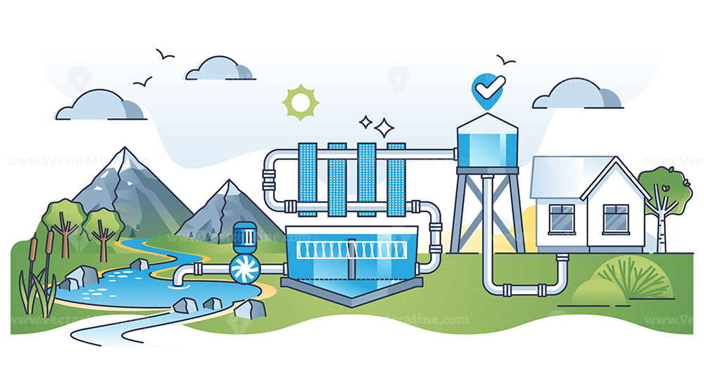
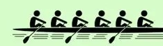
Marketing Channels to Deliver Value
Tehzeeb Karim
IMPORTANCE & FUNCTIONS
Bridging Gaps
Bridging Producer Feasibility and Consumer Choices
A Communication Interface Between Producers and Consumers
Facilitating Transactions Between Producers and Consumers
Logistics and Risk-Bearing on Behalf of Producers
Shaping the Marketing Mix
3.1.1 Shaping the Product
3.1.2 Shaping the Price
3.1.3 Shaping the Place
3.1.4 Shaping the Promotion

Slide 6
Marketing Channels to Deliver Value
Tehzeeb Karim
A value delivery network comprises the constellation of organisations and processes that jointly create and deliver customer value; this perspective shifts attention from isolated transactions to systemic interdependence and coordinated value creation (Kotler, 2003; Rangan, 2014). In practice, the network includes upstream suppliers who provide inputs and capabilities, downstream distributors and retailers who shape the customer experience, and a range of service, financial and information partners that enable transactions and intelligence (Stern, El Ansary & Coughlan, 2012; Rosenbloom, 2011).
IMPORTANCE & FUNCTIONS
Bridging Gaps
Bridging Producer Feasibility and Consumer Choices
A Communication Interface Between Producers and Consumers
Facilitating Transactions Between Producers and Consumers
Logistics and Risk-Bearing on Behalf of Producers
Shaping the Marketing Mix
3.1.1 Shaping the Product
3.1.2 Shaping the Price
3.1.3 Shaping the Place
3.1.4 Shaping the Promotion
The importance of value-creating channels in marketing cannot be overstated. These channels not only bridge the gaps between the producers and consumers (e.g. in communication, supply and demand, constrains and choices,etc) but they also play a pivotal role in shaping the marketing mix for any given product or service. (Rosenbloom, 2011; Kotler & Keller, 2016).

Slide 7
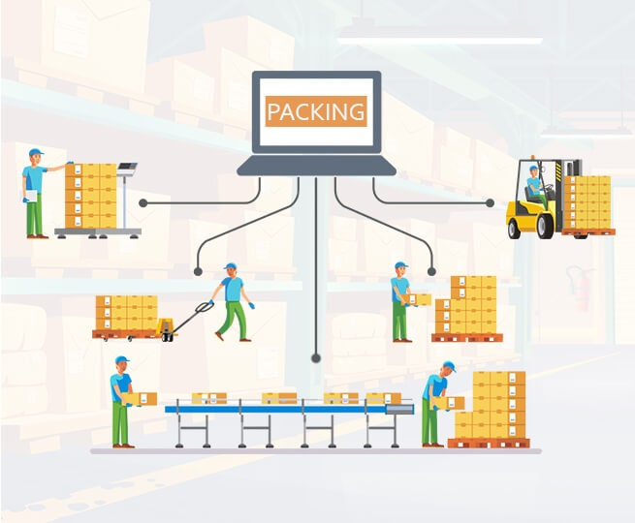
Marketing Channels to Deliver Value
Tehzeeb Karim
Logistics refers to the set of activities concerned with the physical movement, storage and handling of goods and the associated information and financial flows that enable products to move from producers to customers. Supply chain denotes the broader network of organisations — suppliers, manufacturers, logistics providers, intermediaries and customers — that together source inputs, transform them into products and deliver value to end users (Rosenbloom, 2011; Stern, El Ansary & Coughlan, 2012).
LOGISTICS AND SUPPLY CHAIN
What is it?
Objectives
Service Excellence
Cost Minimisation
Inventory Turnover and Working Capital Efficiency
Flexibility and Responsiveness
Risk Reduction and Reliability
Major Logistics Functions
Order Processing
Warehousing
Inventory
Transportation
Information Systems
Integrated Logistics Management

Slide 8
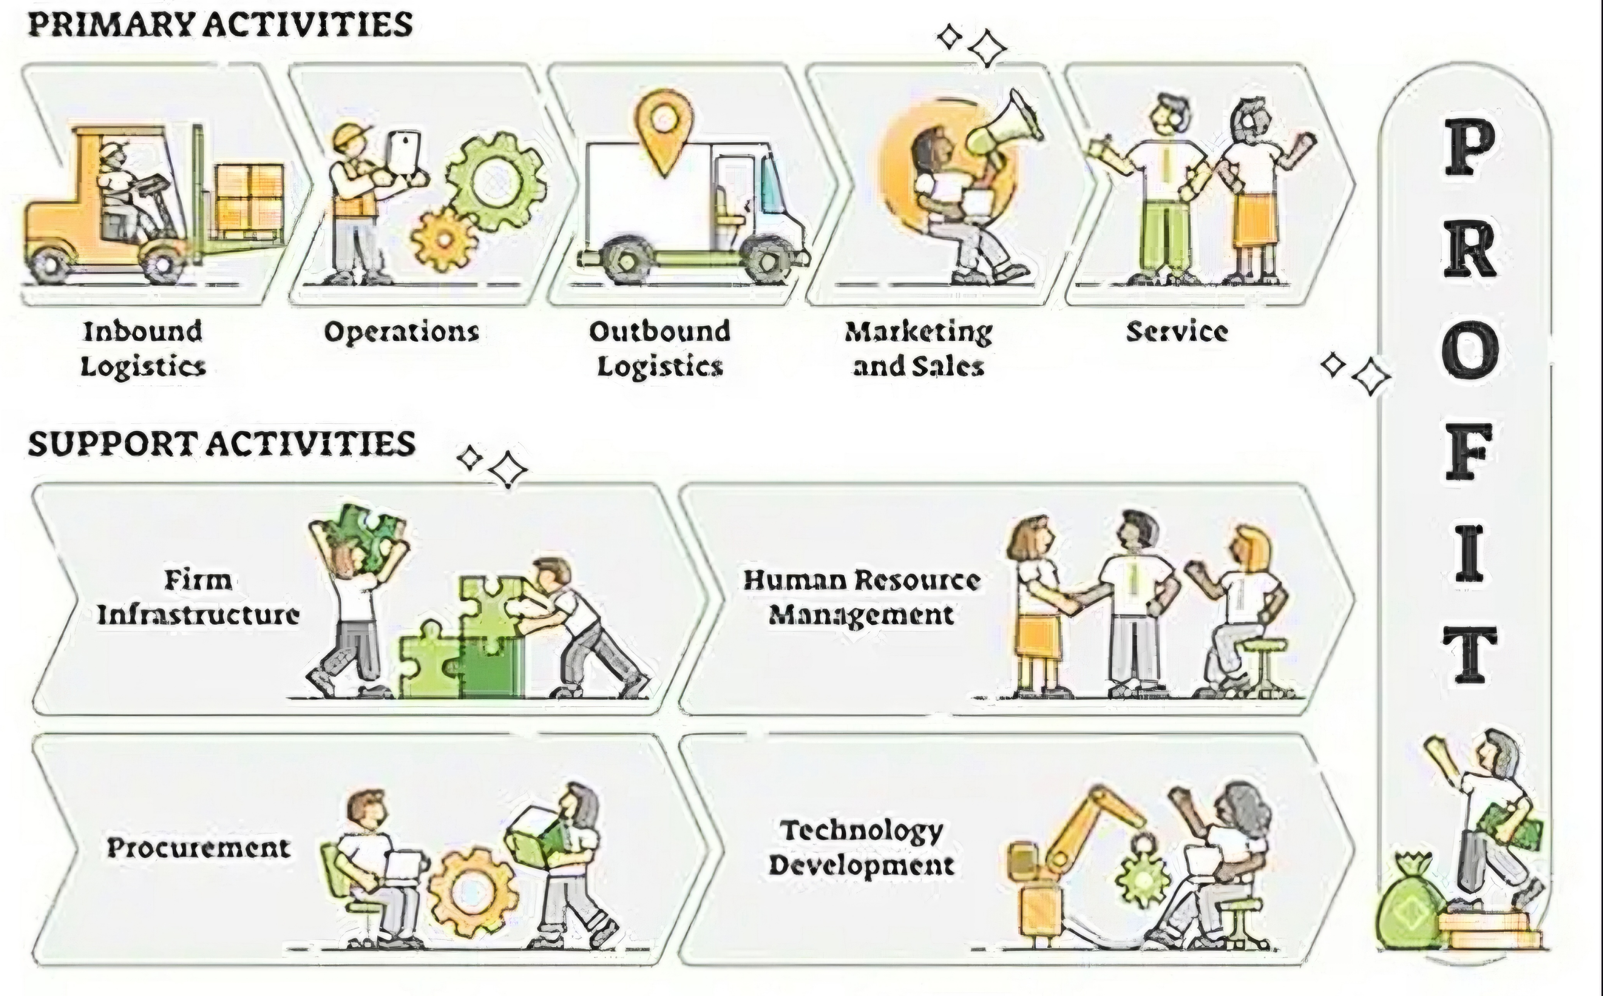
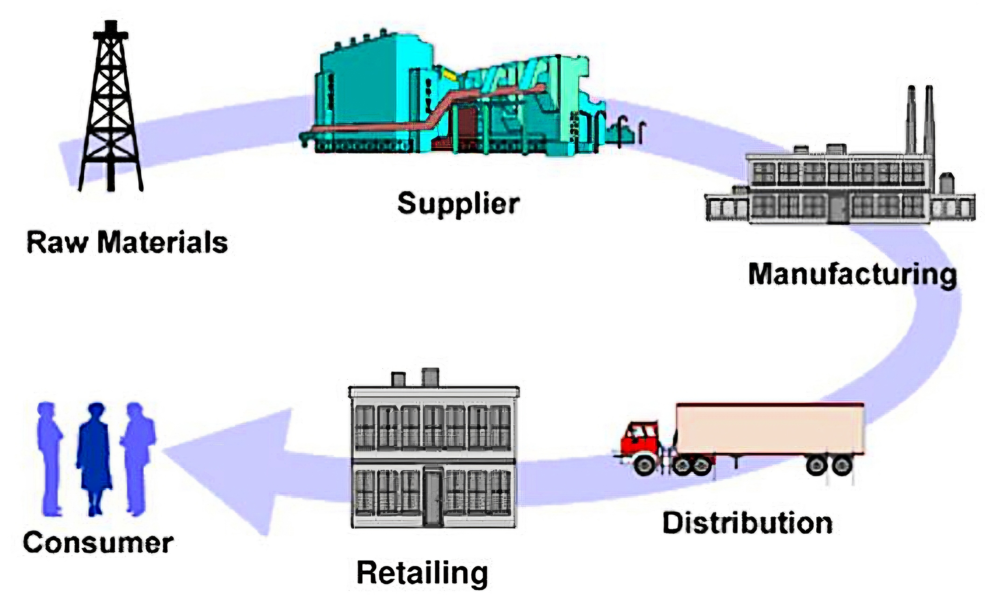
Marketing Channels to Deliver Value
Tehzeeb Karim
FROM Supply Chain Management TO Value Chain Management

Slide 9
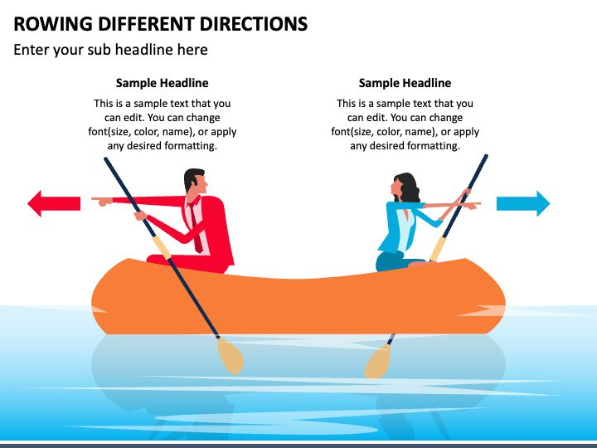
Marketing Channels to Deliver Value
Tehzeeb Karim
Conflict, Control and Competition
Causes of Conflict
Goal Incompatibility
Strategic and Tactical Misalignment
Power Imbalance
Unclear Roles and Rights
Types of Conflicts
Horizontal Conflicts
Vertical Conflicts
Multichannel Conflict
Cooperation involves coordinated actions such as information sharing, joint planning and logistics coordination
Competition denotes rivalrous behaviour for customers, shelf space and margins; conflict arises when divergent interests or expectations lead members to impede one another
(Stern, El Ansary & Coughlan, 2012; Rosenbloom, 2011).

Slide 10
Marketing Channels to Deliver Value
Tehzeeb Karim
Conflict, Control and Competition
Causes of Conflict
Goal Incompatibility
Strategic and Tactical Misalignment
Power Imbalance
Unclear Roles and Rights
Types of Conflicts
Horizontal Conflicts
Vertical Conflicts
Multichannel Conflict
Cooperation involves coordinated actions such as information sharing, joint planning and logistics coordination
Competition denotes rivalrous behaviour for customers, shelf space and margins; conflict arises when divergent interests or expectations lead members to impede one another
(Stern, El Ansary & Coughlan, 2012; Rosenbloom, 2011).
Managing Conflict
Clarification of Strategy
Dual Compensation
Superordinate Goals
Employee Exchange
Joint Memberships
Co-Optation
Diplomacy, Mediation and Arbitration
Legal Recourse

Slide 11

Marketing Channels to Deliver Value
Tehzeeb Karim
Power in marketing channels is the capacity of one member to influence another’s behaviour, decisions or outcomes within the value‑creation network, shaping coordination, conflict, governance and the allocation of functions such as pricing, promotion and logistics (Stern, El Ansary & Coughlan, 2012; Rosenbloom 2011).
Power Dynamics
Power Dynamics
What? And why important?
Coercive Power
Reward Power
Legal Power
Expert Power
Referent Power
Power can be a source of leverage to secure favourable terms and as a managerial resource that must be exercised with regard to long‑term relationships, contractual constraints and reputational effects (Pénard, Raynaud & Saussier, 2003; Frazier, 2025).

Slide 12
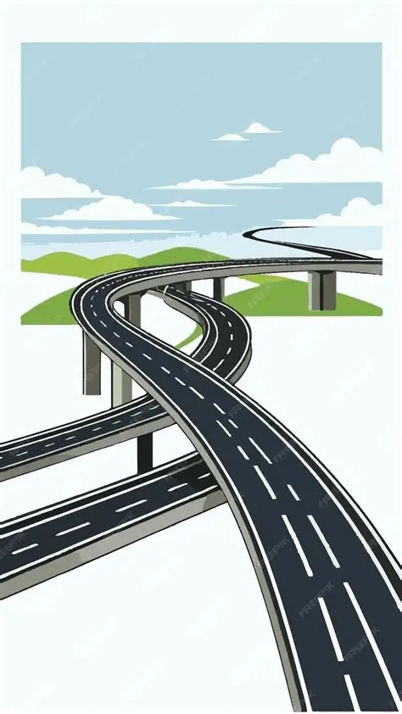
Marketing Channels to Deliver Value
Tehzeeb Karim
Channel design is the managerial process of specifying the structure, functions and governance of the distribution system through which a firm’s products or services reach end customers.
It encompasses decisions about which channels to use, the number and type of intermediaries, the allocation of responsibilities, and the contractual and relational mechanisms that coordinate activity (Rosenbloom, 2011; Kotler & Keller, 2016).
A balancing exercise among coverage, control and cost (Rosenbloom, 2011; Stern, El Ansary & Coughlan, 2012).
Kotler & Keller (2016) emphasise alignment with customer needs and brand strategy
Mentzer & Williams (2001) highlight logistics capabilities as a determinant of feasible designs.
DESIGN & EVALUATION
What and why?
Needs Analysis
Objectives and Constraints
Channel Considerations
Intermediary Considerations
Conventional Channels
Vertical Marketing Systems
- Corporate VMS
- Administered VMS
- Contractual VMS
Horizontal Marketing Systems
- Retailer Alliances
- Manufacturer Co-Distribution Agreements
- Joint Ventures
Disintermediation

Slide 13



Marketing Channels to Deliver Value
Tehzeeb Karim
MANAGING CHANNELS
Synergy and Sustainability
Not Just Intermediaries
Synergy & Value-Creation
Aligned Values
Motivation, Monitoring and Evaluation
Integrating Sustainability

Slide 14
Marketing Channels to Deliver Value
Tehzeeb Karim
MANAGING CHANNELS
Questions ?

